Slide 1
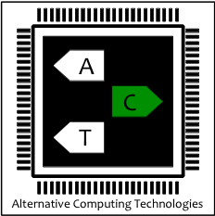
Reinforcement Learning and Adaptive Sampling for Optimized DNN Compilation
Byung Hoon Ahn, Prannoy Pilligundla, Hadi Esmaeilzadeh
Alternative Computing Technologies (ACT) Lab
University of California, San Diego
Notes:
Good morning
My name is Byung Hoon Ahn
I will be presenting our work on Reinforcement Learning and Adaptive Sampling for Optimized DNN Compilation

Slide 2
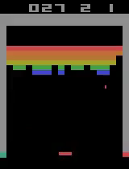
Neural network compilation
Deep learning compiler’s objective is to
Speed Up deep learning models’ inference, detection…
Notes:
As you know DNN has been successful in various domains.
However, their immense computation is a problem yet to be solved completely.
As with other applications, we have deep learning compilers that can SPEED UP deep learning model’s inference,
Enabling their deployment to various devices.

Slide 3
Neural network compilation
Code Template
Design Space
Dimension / Knob
Description
tile_f, tile_y, tile_x
Tiling and binding for # of filters, height,
and width of feature map
tile_rc, tile_ry, tile_rx
Tiling and binding for reduction axis such as
channels, height, and width of filters
auto_unroll_max_step
Threshold of # of steps in the loop to be
automatically unrolled during code generation
unroll_explicit
Explicit hint for code generation phase
to unroll the loop
Notes:
So how is deep learning models compiled?
There are two large steps
First, there is a frontend compiler,
Then, an optimizing compiler
Frontend compiler is composed of two components, where
Target independent passes perform operation fusion and data layout transformation, and
Target dependent passes perform transformations or optimization that is specific to the target hardware.
This emits code templates (as you can see on the bottom left) which allow tiling, loop unrolling, and etc. depending on the kernel.
So depending on what can be tuned (which we call knobs) we have a design space that is defined with multiple knobs.

Slide 4
Neural network compilation
Code Template
Design Space
Dimension / Knob
Description
tile_f, tile_y, tile_x
Tiling and binding for # of filters, height,
and width of feature map
tile_rc, tile_ry, tile_rx
Tiling and binding for reduction axis such as
channels, height, and width of filters
auto_unroll_max_step
Threshold of # of steps in the loop to be
automatically unrolled during code generation
Optimizing Compiler’s Objective is to
Find Optimal Configuration
unroll_explicit
Explicit hint for code generation phase
to unroll the loop
Notes:
Optimizing compiler’s job is to find optimal configuration of the knobs for maximized performance

Slide 5
Prohibitive optimization time limits further innovation and diversity in neural networks
Takes Over 10 Hours to Optimize ResNet-18
Notes:
However, such optimization takes long time.
For example even a relatively small network, ResNet-18, takes over 10 hours to optimize
And such prohibitive optimization time limits further innovation and diversity in neural networks

Slide 6
Challenges
1
2
How to improve
efficacy of the search?
How to reduce costly
hardware measurements?
Notes:
In order to alleviate that, we need to overcome two challenges.
Improving efficacy of the search
Reducing number of costly hardware measurements

Slide 7
Challenges
1
2
How to improve
efficacy of the search?
How to reduce costly
hardware measurements?
We need to overcome two interrelated challenges
Notes:
These to challenges are interrelated

Slide 8
RELEASE
Reinforcement Learning Compiler with Adaptive Sampling for Efficiency
Reinforcement Learning improves Search Efficacy
Adaptive Sampling improves Sample Efficiency
Notes:
In order to overcome such issue, we introduce ReLeASE,
Reinforcement Learning Compiler with Adaptive Sampling for Efficiency
This uses a cost model to approximate runtime measurements of target hardware
Then we use reinforcement learning to improve search efficacy, and
Adaptive sampling to improve sample efficiency

Slide 9
Challenges
1
2
How to improve
efficacy of the search?
How to reduce costly
hardware measurements?
We need to overcome two interrelated challenges
Notes:
So we will go through one by one
So how do we improve efficacy of the search

Slide 10
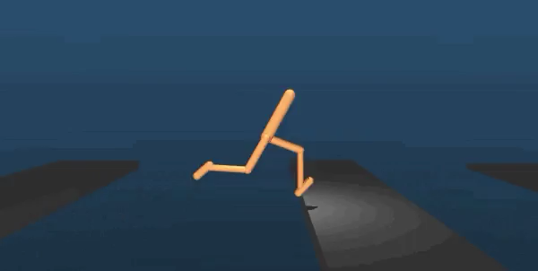
RL has been successful with autonomous decision making in complex settings
Apply Reinforcement Learning to Search Process
Notes:
As we can see in the video, reinforcement learning has been successful with autonomous decision making in complex settings.
So our proposal is to apply reinforcement learning to the search process

Slide 11
RL-based Search Agent
Start off with initial set of points (128) For each point…
Notes:
Here I will go through the steps one by one
We start off with a randomly initialized set of points
Then for each point,

Slide 12
RL-based Search Agent
2. Pass it through policy network for action (increment ↑,
stay -,
decrement ↓)
Notes:
We pass it through the policy network for action (increment stay decrement for each knob)

Slide 13
RL-based Search Agent
3. Use configuration updater to acquire new configuration
Notes:
Then we feed the original configuration and the action to the configuration updater to acquire next configuration.
Then we call this a single search step

Slide 14
RL-based Search Agent
4. Repeat the search step 500 times = episode
Notes:
We repeat this for 500 search steps, then we call it episode.

Slide 15
RL-based Search Agent
5. Update agent using reward (estimated hardware measurement)
Notes:
Then using the configurations acquired, we feed it to the cost model and get approximated hardware measurement then use that as a surrogate reward to update the agent

Slide 16
RL-based Search Agent
6. Repeat this episode for all 128 points
…
Notes:
We repeat this process for all 128 points

Slide 17
We have 128 x 500 = 64,000 samples
64,000 are too many to be measured on real hardware
1s x 64,000 = 18 hours
Notes:
After this, we should be left with 128 x 500 points,
Which is 64 k points.
If we assume it takes 1 second to measure one,
It would take 18 hours to measure all of them
This is unrealistic

Slide 18
We have 128 x 500 = 64,000 samples
64,000 are too many to be measured on real hardware
1s x 64,000 = 18 hours
How to choose meaningful samples to measure on real hardware?
Notes:
So how do we choose meaningful samples to measure on real hardware

Slide 19
Challenges
1
2
How to improve
efficacy of the search?
How to reduce costly
hardware measurements?
We need to overcome two interrelated challenges
Notes:
This brings us to our second question
So how do we reduce costly hardware measurements, or reduce samples?

Slide 20
Analyzing the configuration sample distribution
Notes:
In order to solve this, we first analyzed configuration sample distribution.

Slide 21
Analyzing the configuration sample distribution
Reduce cluster to point that are each
representative of the cluster
Notes:
As you can see there were some clusters
So It is natural to think, that we can reduce those clusters to point that are each representative of the cluster

Slide 22
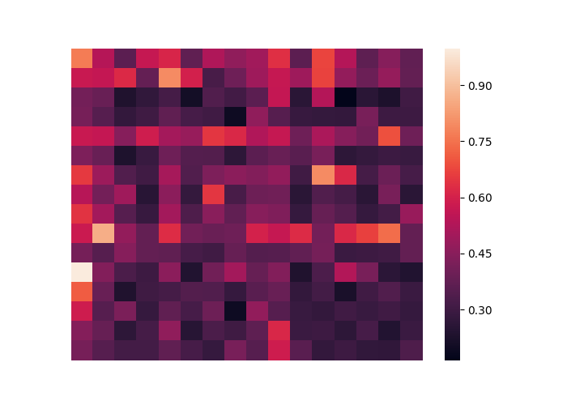
Wouldn’t that compromise performance?
Relatively
good region
Tile_y
TFLOP
Relatively
bad region
tile_x
Although the search space is unstructured
changes along the axis are gradual
Notes:
However, one may ask, “wouldn’t that compromise performance?”
Yes and no…
Since when I took my time to measure comprehensive set of configurations for some layers,
I found that although the search space is unstructured, changes along the axis are gradual

Slide 23
How many clusters?
Less centroids = Faster optimization
More centroids = Better output code perf.
Iterate through different number of centroids and find knee of the loss curve
knee = pareto optimality
Notes:
So starting with the base that ”clustering works”
We need to determine number of clusters.
Number of clusters or centroids is very important
Because less centroids would mean faster optimization, and
More centroids would mean that we would test more configurations for better output code performance.
In order to solve this we simply iterate through different number of centroids and find knee of the loss curve, where the knee is the pareto optimal point.

Slide 24
Adaptive sampling algorithm
Notes:
So this is our final algorithm
For some cases where we have some redundancies in among clusters, we would replace them with new synthetic samples that are made of modes of each dimensions to foster effective exploration.

Slide 25
Benchmarks for RELEASE
Evaluation
Name
Description
Layer Type
Dataset
No. of Tasks
AlexNet
Image Classification
Convolution
ImageNet
5
VGG-16
Image Classification
Convolution
9
ResNet-18
Image Classification
Convolution
12
Hardware
Name
Description
Titan Xp
Server-class GPU
Notes:
So for evaluation we used AlexNet, VGG-16, and ResNet-18
And used Titan Xp as our target hardware, but can be extended to other hardware too.

Slide 26
RL-based Search Agent
Reinforcement Learning based search shows 2.88x improvement
in search steps over Simulated Annealing in AutoTVM
Notes:
So first, for RL-based search agent
We see that RL based search agent shows 2.88x improvement in search steps over simulated annealing in AutoTVM (which is the state-of-the-art)
And taking advantage of this helped us alleviate the overhead of running reinforcement learning which is heavier compared to simulated annealing

Slide 27
Adaptive Sampling Module
Adaptive Sampling shows 2.33x improvement for RL-based search in sample efficiency over Naïve sampling
Adaptive Sampling even shows 1.98x improvement
for Simulated Annealing in AutoTVM
Notes:
Furthermore, our adaptive sampling showed that it achieves 2.33x improvement in sample efficiency, and showed 1.98x improvement with simulated annealing too!

Slide 28
Putting it all together
RELEASE achieves better performance
with less hardware measurements than AutoTVM
Notes:
So putting them together,
You can see that (focusing on the Y axis) ReLeASE achieved better performance
with (focusing on the X axis) less hardware measurements.

Slide 29
RELEASE
RELEASE shows 4.00x improvement in optimization time
with 5.6% improvement in output performance than AutoTVM
Notes:
Overall, when we tested this on end-to-end neural networks,
We found 4.00x improvement in optimization time with 5.6% improvement in output performance over State-of-the-art

Slide 30
Conclusion
We formulating optimizing compilation of DNNs as a Reinforcement Learning problem in contrast to simulated annealing taking fewer steps to converge to better or same quality solution.
We devise an Adaptive Sampling algorithm that leverages clustering to focus measurements to representative samples, reducing number of measurements while keeping their relevance to search high.
Notes:
In conclusion,
(1) We formulate optimizing compilation of DNNs as a RL problem in contrast to simulated annealing, and took less steps to converge to better of same quality solution
(2) We devised an adaptive sampling algorithm that leverages clustering to focus costly hardware measurements to representative samples.
Overall, we were able to achieve FASTER yet MORE EFFECTIVE compilation of Deep Neural Networks.
Thank you

